Slide 1
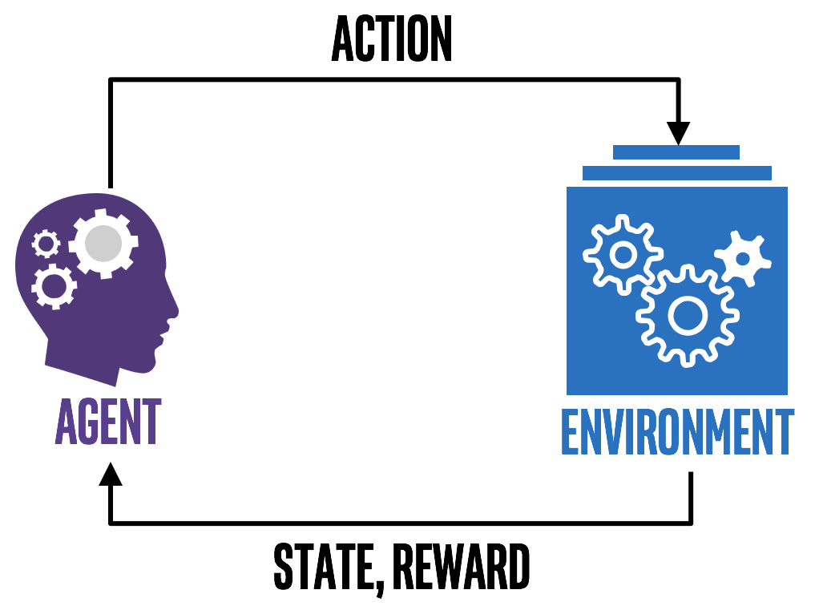
Fundamentals of Reinforcement Learning
Part-I
Notes:
1

Slide 2
What is Reinforcement Learning?
Reinforcement learning is learning what to do—how to map situations to actions—so as to maximize a numerical reward signal [Sutton, Barto]
Notes:
2

Slide 3
What is Reinforcement Learning?
Reinforcement learning is learning what to do—how to map situations to actions—so as to maximize a numerical reward signal [Sutton, Barto]
The learner is not told which actions to take, but instead must discover which actions yield the most reward by trying them [Sutton, Barto]
Notes:
3

Slide 4
Reinforcement Learning vs Traditional ML
Supervised Learning
Notes:
4

Slide 5
Reinforcement Learning vs Traditional ML
Supervised Learning
Unsupervised Learning
Notes:
5

Slide 6
Reinforcement Learning vs Traditional ML
Supervised Learning
Unsupervised Learning
Reinforcement Learning
Notes:
6

Slide 7
Reinforcement Learning Terminology
Agent
Notes:
7

Slide 8
Reinforcement Learning Terminology
Agent
Environment
Notes:
8

Slide 9
Reinforcement Learning Terminology
Agent
Environment
State
Notes:
9

Slide 10
Reinforcement Learning Terminology
Agent
Environment
State
Action
Notes:
10

Slide 11
Reinforcement Learning Terminology
Agent
Environment
State
Action
Transition
Notes:
11

Slide 12
Reinforcement Learning Terminology
6. Transition Probability
Notes:
12

Slide 13
Reinforcement Learning Terminology
6. Transition Probability
7. Immediate Reward
Notes:
13

Slide 14
Reinforcement Learning Terminology
6. Transition Probability
7. Immediate Reward
8. Average Reward
Notes:
14

Slide 15
Reinforcement Learning Terminology
6. Transition Probability
7. Immediate Reward
8. Average Reward
9. Discounted Reward
Notes:
15

Slide 16
Reinforcement Learning Terminology
6. Transition Probability
7. Immediate Reward
8. Average Reward
9. Discounted Reward
10. Markov Decision Process
Notes:
16

Slide 17
What next?
R-SMART
Notes:
17

